Slide 1

Low Voltage System
Basilis Amoiridis
Sokratis Koseoglou
.
.
.

Slide 2


Low Voltage System
Presentation Chronicle
Part One
Part Two
Part Three
Part Four
Part Five

Slide 3
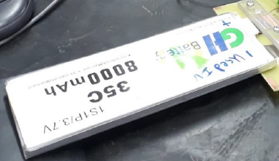
Low Voltage System
Internal Resistance PCB
Lithium Polymer Battery (LiPo)
Low weight-to-volume ratio
High Cost
Small Life Cycle

Slide 4
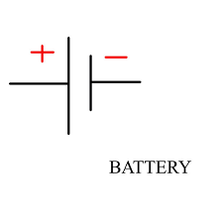
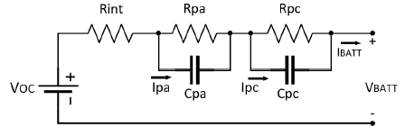
Low Voltage System
Internal Resistance PCB
How we think it is…
VBATT = V+ - V-
How it actually is…
VBATT = Voc + Ibatt* Rint +VRC

Slide 5
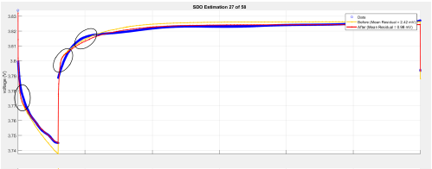
Low Voltage System
Internal Resistance PCB
Voltage Drop Curve…
VRC
Open circuit steady-state
VRinternal

Slide 6
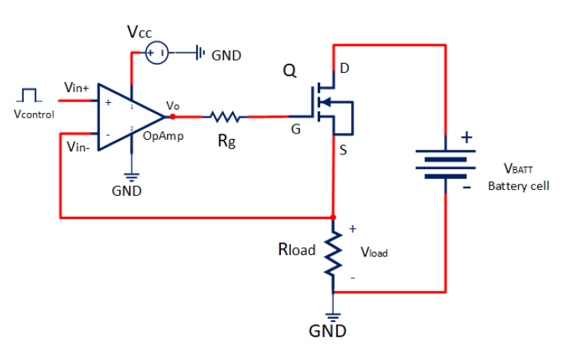
Low Voltage System
VBATT = VOC + ID * RIN
Internal Resistance PCB
ID
ID
ID
Vcontrol
= Vin-
= Vload
ID = VLOAD / RLOAD

Slide 7
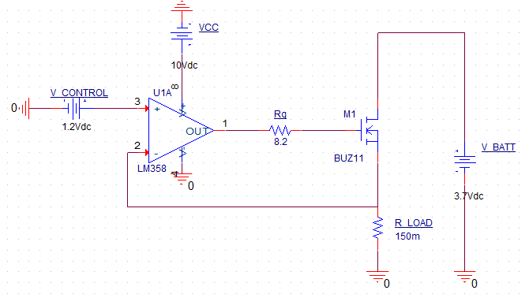
Low Voltage System
Internal Resistance PCB
pSpice Simulation…

Slide 8
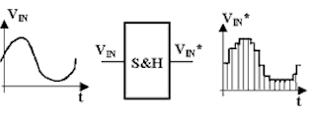
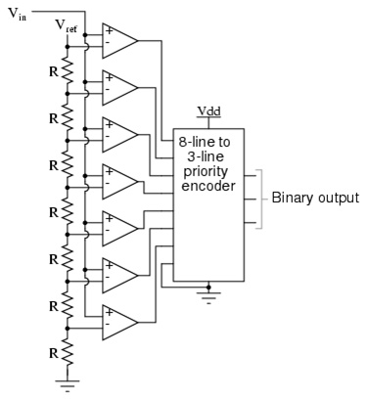
Low Voltage System
Internal Resistance PCB
ADC (Analog-to-Digital Converter)
10bit – 16bit ADCs
2^n – 1 Comparators
Vref/2^n = 1 LSB

Slide 9
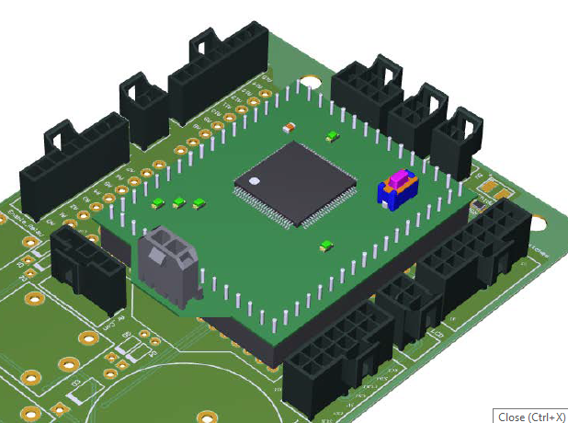
Low Voltage System
Internal Resistance PCB
Our MCU (Microcontroller Unit)…
10bit ADC
Which means…
5/2^10 = 4.8mV
R = V/I = 4.8m/8A= 0.6mΩ
12bit ADC…
5/2^12 = 1.2mV
R = V/I = 1.2mV/8A = 0.15mΩ
Aristuino

Slide 10
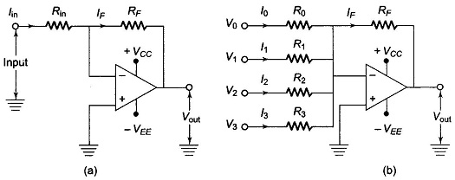
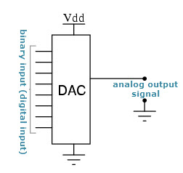
Low Voltage System
Internal Resistance PCB
DAC (Digital-to-Analog Converter)
The classic way…

Slide 11
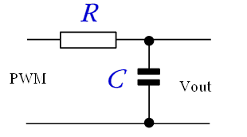

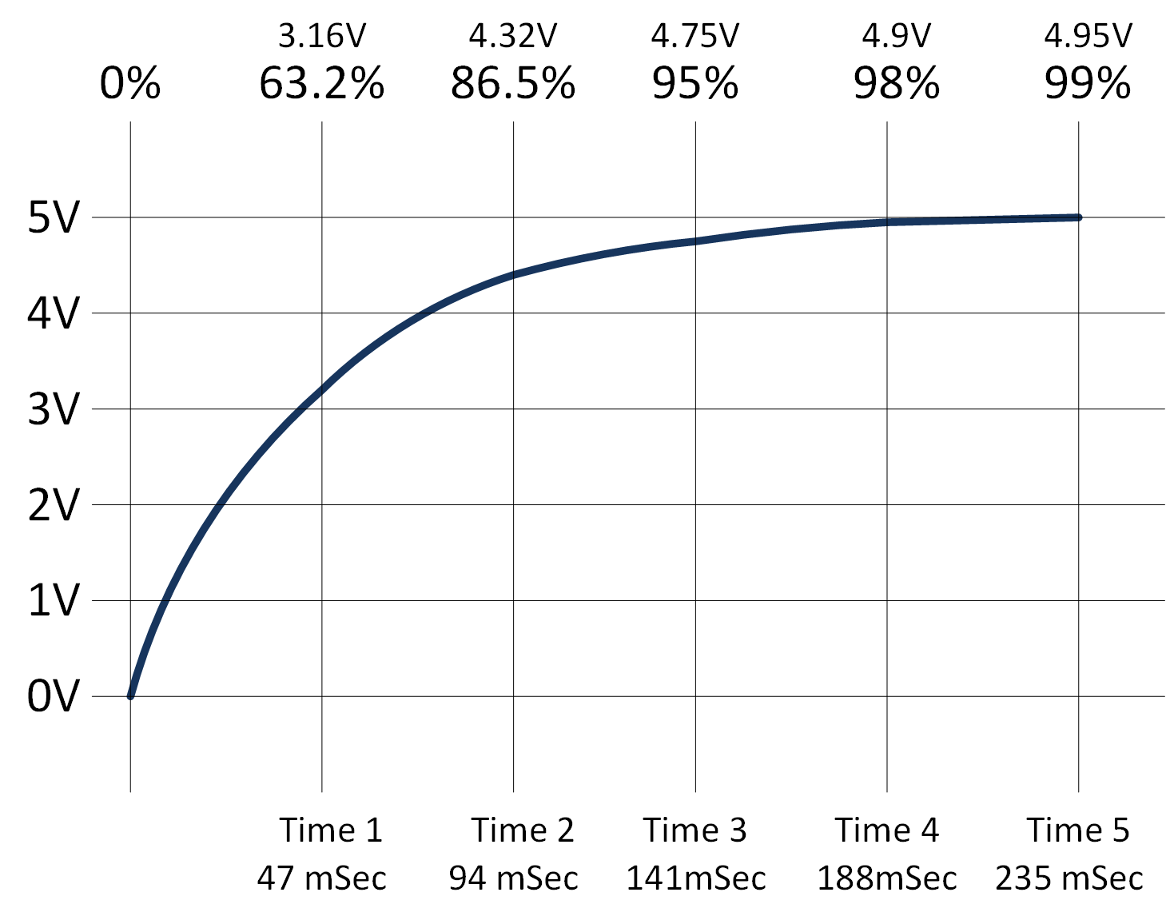
Low Voltage System
Internal Resistance PCB
DAC (Digital-to-Analog Converter)
The other way… PWM for Analog Output
0V
1.25V
2.5V
3.75V
5V

Slide 12
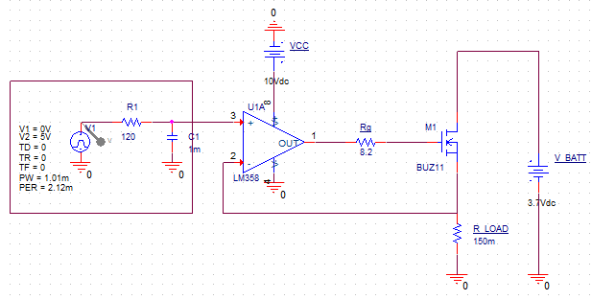
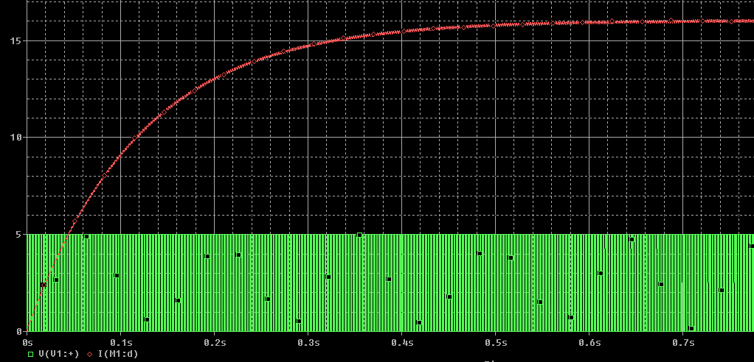
Low Voltage System
PWM with RC filter
Internal Resistance PCB
High Rise Time Delay...
800ms

Slide 13
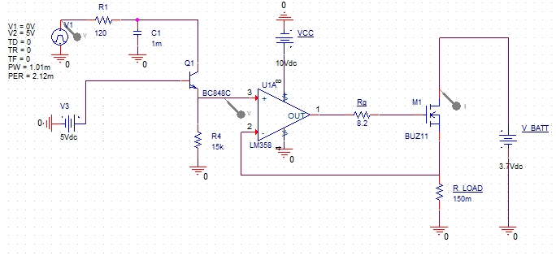
Low Voltage System
Internal Resistance PCB
Time delay problem solved by adding a BJT switch which will close after 800ms…

Slide 14
Low Voltage System
Internal Resistance PCB
Weekend Goals…
LCD display and Start Button adding
PCB design
Excel Creation

Slide 15


UESTIONS

Slide 16


